Slide 1
1
Typed languages
6
Polymorphism
OOP
2
Object/Class
5
Inheritance
3
Aggregation
4
Encapsulation

Slide 2
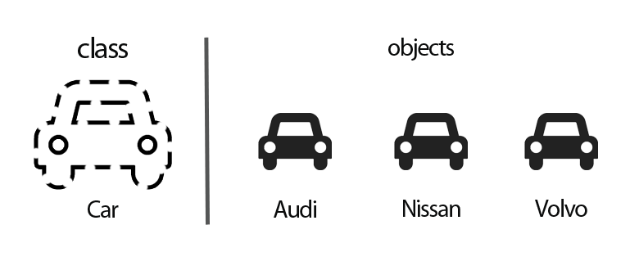
SO FAR YOU KNOW HOW TO
CREATE AN OBJECT FROM A CLASS
Let myCar = new Car(“audi”);

Slide 3

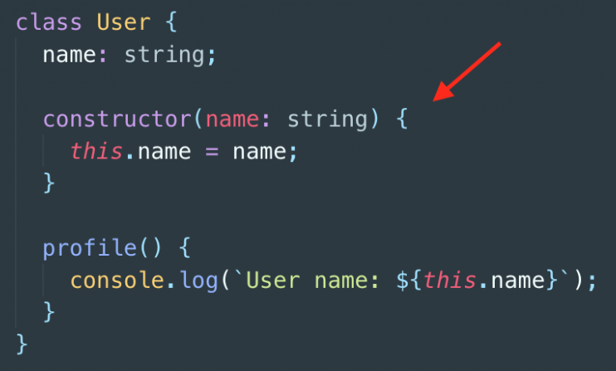
Does the constructor have a return type ?
A - YES
B - NO

Slide 4

NOW LET’S COMBINE
OBJECTS TOGETHER
AGREGATION

Slide 5






A house can have MANY tree
Each tree has a specific SIZE

Slide 6

In OOP, we represent these 2 classes as follows:
House
Tree
*
Class diagram
numberDoors : number
size: number
owner : string
MANY

Slide 7
In typescript , we represent these 2 classes as follows:
class House {
numberDoor: number;
owner: string;
constructor(numberDoor: number, owner: string) {
this.numberDoor = numberDoor;
this.owner = owner;
}
}
class Tree {
size: number;
constructor(size: number) {
this.size = size;
}
}
Code :

Slide 8

ACTIVITY 1
// 1- update the class to allow the house to have "many" tree
// 2- Add the 2 trees to the houseRonan
House
Tree
*

Slide 9
‘A is composed of many B’
A
*
B
Class diagram
class A {
theB: B[];
}
Class B {
}
Code :

Slide 10
Add an objet to another objet
VERSION 1
class House {
allRooms: Room[] = [];
}
// Create a house
let house1 = new House();
// Create a room
let room1 = new Room();
// Add the room to the house
house1.push(room1);
By default the list of room
Is empty
We add the room to the house

Slide 11
Add an objet to another objet
VERSION 2
class House {
allRooms: Room[] = [];
addRoom(room: Room) {
this.allRooms.push(room)
}
}
// Create a house
let house1 = new House();
// Create a room
let room1 = new Room();
// Add the room to the house
house1.addRoom(room1);
By default the list of room
Is empty
We create a method inside the class
To add the room
We add the room to the house

Slide 12
ACTIVITY 2
// 1- Create:
- 1 house
- 3 doors
- 2 rooms
// 2- Add the 2 rooms to the house
// 3 – Add a door to the house and rooms
Door
House
*
*
*
Room

Slide 13

A man has 1 left arm and 1 right arm

Slide 14
In OOP, we represent these 2 classes as follows:
Man
2
Arm
Class diagram
age : number
isLeftArm: boolean
name : string

Slide 15
In typescript , we represent these 2 classes as follows:
class Man {
leftArm: Arm = new Arm(true);
rightArm: Arm = new Arm(false);
}
class Arm {
isLeft: boolean;
constructor(isLeft: boolean){
this.isLeft = isLeft
}
}

Slide 16
‘A has 1 B’
School
1
Director
class School {
director: Director;
}
Class Director {
}

Slide 17

ACTIVITY 3
// 1- Update the classes to mange
// - a school has many students
// - as school has 1 director
// 2 - Create a school with a director,
and students
School
*
Student
0/1
Director

Slide 18
A team can have or not a coach
Team
0/1
Coach
class Team {
coach?: Coach;
}
Class Coach {
}
The coach
Is optional

Slide 19

What is a UML class diagram ?
CLASS NAME
School
A way to represent the class graphically
Name:string
Superficy:number
ATTRIBTES
Similar to ERDs
METHODS
getSchoolSize() : number

Slide 20

TO SUM UP
We saw 3 types of aggregations
“A HAS MANY B”
“A HAS ALWAYS 2 B”
“A HAS 0 or 1 B”
A
B
A
B
A
0/1
B
*
2
We create an array
In A
We create 2 attributes B
In A
We create 1 attribute B
In A
But it is optional

Slide 21

WANT TO GO FURTHER ?
CLASSES & OBJECTS IN TYPESCRIPT
https://www.typescriptlang.org/docs/handbook/classes.html

